Slide 1
Sub- Human Resource Management
Class – B.Tech
Sem – VII
By-
Prof. Priti Yamdagni

Slide 2
Human Resource Planning
The biggest challenge is the numbers. The numbers are just so large. But the issue is no different than the one (founder) Sam Walton faced. We have to focus on one associate at a time.
HRP is a process by which an organisation ensures that it has the right number & kind of people at the right place and at the right time, capable of effectively and efficiently completing those tasks that help the organisation achieve its overall objectives.
What is HRP?
 The process of Deciding what positions the firm will and how to fill them.
 The process of forecasting the supply and demand for human resources within an organisation and developing action plans for aligning the two.

Slide 3
E.W Vetter viewed human resources planning
as ―a process by which an
organization should move from its current manpower position to its desired
manpower position. Through planning management strives to have the right
number and right kind of people at the right places at the right time, doing things
which result in both the organization and the individual receiving maximum
long-run benefit.
According to Leon C Megginson human resources planning is an integrated
approach to performing the planning aspects of the personnel function in order to
have a sufficient supply of adequately developed and motivated people to
perform the duties and tasks required to meet organizational objectives and
satisfy the individual needs and goals of organizational members.

Slide 4
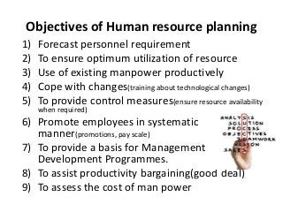

Slide 5
HR departments are responsible for the following tasks:
 Recruitment, Selection
 Evaluating, creating and administering compensation and benefits programs
 Training and professional development
 Employee manuals
 Time and attendance etc.
Planning:
 Business should always have a strategic plan.
 SP- identifies the company goals and objectives and communicates these goals.
 Develops a sense of ownership of the plan.
 Build consensus about where an organization is going

Slide 6
Importance of HRP
 Planning is important for HRM.
 Each Organization needs personnel with necessary qualifications, skills, knowledge, experience & aptitude.
 Need for Replacement of Personnel - Replacing old, retired or disabled personnel.
 Meet manpower shortages due to labour turnover - Indian Airlines, Gas Authority of India headless for 10 months.
 Meet needs of expansion / downsizing programmes - As a result of expansion of IT companies the demand for IT professionals are increasing. PSU‟s offering VRS to employees to retrench staff and labour costs. DOT.COMs firing staff.
 Cater to Future Personnel Needs - Avoid surplus or deficiency of labour. [OverstaffedRedeployment].
 Nature of present workforce in relation with Changing Environment - helps to cope with changes in competitive forces, markets, technology, products and government regulations.

Slide 7
HRP comprises A Four Steps Process
The first step is to develop a strategy planning which matches with the Organisations Vision, Mission and values.
 Increase the profit
 Satisfy the partners
 Finding new customers
 Developing quality products and tools
 Eliminate the non-profitable measures.
For example-The 2016's mission is You Must Be A STAR
S - Speed
T - Team
A - Approach
R - Results
The vision: Build, create the environment& culture that attracts, retains, and breeds the present and future leaders, expertise &innovators
The Core values
 Reward  Resourcing  Development  Employee relations Priorities:  Improve Customer Experience  Grow Revenue.  Improve Profitability & cash flow.  Create a great employee experience  Live our Values.

Slide 8
2. The second step is predicting Demand for HR
 Decrease costs
 Vacant jobs
 Train on new equipment. MRCET MBA
3. The third step is Determining HR Supply available
 DAP development action plan
 Improve the skills of employees
 Link with employees needs
 Analyze and choose the common needs
 Appraisal at the end of the year in developing the employees skills
 Replacement charts.

Slide 9
4 .The last steps is Formulating the Plans for Action:
Decisions with a shortage of employees: Selection, overtime, recruitment
Organizational Objectives & Policies:
 Downsizing / Expansion
 Acquisition / Merger / Sell-out  Technology up gradation / Automation
 New Markets & New Products
 External Vs Internal hiring
 Training & Re-training
 Union Constraints

Slide 10
Case Study
How FCO Meet Business Needs through Workforce Planning
The staffing needs of an organization change constantly. Without proper planning,
an organization may suffer from skills shortages. It may be unable to provide a
good service because it does not have sufficient staff with the right experience.
Workforce planning involves estimating the present and future staffing
requirements of the organization. It needs to take into account that:
existing employees may retire, resign or get promoted
new technology may change working methods and require different skill sets
More staff (or staff with different skills) may be needed to fulfill new
business or operational requirements.
The process helps the FCO to identify what skills it needs to deliver its strategic
objectives. It helps it assess the skills available within the existing workforce and
see where there might be gaps in the future. Workforce planning involves
thinking ahead to fit individuals with the right skills into different parts of the
organization.
The FCO has to undertake this planning in the context of the current political and
economic environment. Workforce planning can be a challenge. As an
organization with operations in countries across the world, the FCO has to ensure
balanced workloads for employees both within the UK and overseas. It faces the
challenge of rotating staff between different overseas postings.

Slide 11
What is HR Demand Forecasting?
HR Demand forecasting must consider several factors-both external as well as internal. Among the external factors are competition (foreign and domestic), economic climate, laws and regulatory bodies, changes in technology, and social factors. Internal factors include budget constraints, production levels, new products and services, organisational structure, and employee separations. Demand forecasting is common among organisations, though they may not do personnel-supply forecasting.
Reasons to Conduct Demand Forecasting
There are several good reasons to conduct demand forecasting. It can help:
quantify the jobs necessary for producing a given number of goods, or offering a given amount of services
(ii) determine what staff-mix is desirable in the future
(iii) assess appropriate staffing levels in different parts of the organization so as to avoid unnecessary costs
(iv) prevent shortages of people where and when they are needed most; and
(v) monitor compliance with legal requirements with regard to reservation of jobs.

Slide 12
HR Forecasting Techniques
HR Forecasting techniques vary from simple to sophisticated ones. Before describing each technique, it may be stated that organizations generally follow more than one technique. The techniques are:
1. Ratio-trend analysis
2. Regression analysis
3. Work-study techniques
4. Delphi technique
5. Flow models
6. Other forecasting techniques
1. Ratio-trend Analysis
This is the quickest HR forecasting technique. The technique involves studying·past ratios, say, between the number of workers and sales in an organization and forecasting future ratios, making some allowance or changes in the organization or its methods.

Slide 13
2. Regression Analysis
This is similar to the ratio-trend analysis in that forecast is based on the relationship between sales volume and employee size. However, regression analysis is more statistically sophisticated. A firm first draws a diagram depicting the relationship between sales and workforce size.
It then calculates a regression line – a line that cuts right through the center of the points on the diagram. By observing the regression line, one can find out the number of employees required at each volume of sales.
3. Work-study Techniques
Work-study techniques can be used when it is possible to apply work measurement to calculate the length of operations and the amount of labor required.
The starting point in a manufacturing company is the production budget, prepared in terms of volumes of saleable products for the company as a whole, or volumes of output for individual departments.
The budgets of productive hours are then compiled using standard hours for direct labor. The standard hours per unit of output are then multiplied by the planned volume of units to be produced to give the total number of planned hours for the period. This is then divided by the number of actual working hours for an individual operator to show the number of operators required.

Slide 14

4. Delphi Techniques
Delphi Technique Named after the ancient Greek Oracle at the city of Delphi, the Delphi technique is a method of forecasting personnel needs. It solicits estimates of personnel needs from a group of experts, usually managers. The human resource planning (HRP) experts act as intermediaries, summarize the various responses and report the findings back to the experts.
The experts are surveyed again after they receive this feedback. Summaries and surveys are repeated until the experts’ opinions begin to agree. The agreement reached is the forecast of the personnel needs. The distinguishing feature of the Delphi technique is the absence of interaction among experts.

Slide 15
5. Flow Models
Flow models are very frequently associated with forecasting personnel needs. The simplest one is called the Markov model. In this technique, the forecasters will:
1. Determine the time that should be covered. Shorter lengths of time are generally more accurate than longer ones. However, the time horizon depends on the length of the HR plan which, in tum, is determined by the strategic plan of the organization.
2. Establish categories, also called states, to which employees can be assigned. These categories must not overlap and must take into account every possible category to which an individual can be assigned. The number of states can neither be too large nor too small.
3. Count annual movements (also called ‘ flows’) among states for several time periods. These states are defined as absorbing (gains or losses to the company) or non-absorbing (change in position levels or employment status). Losses include death or disability, absences, resignations, and retirements. Gains include hiring, rehiring, transfer, and movement by position level.

Slide 16
4. Estimate the probability of transitions from one state to another based on past trends. Demand is a function of replacing those who make a transition.
There are alternatives to the simple Markov model. One, called the semi-Markov, takes into account not just the category but also the tenure of individuals in each category. After all, the likelihood of movement increases with tenure.
Another method is called the vacancy model, which predicts probabilities of movement and the number of vacancies. While the semi-Markov model helps estimate movement among those whose situations and tenure are similar, the vacancy model produces the best results for an organization.
Markov analysis is advantageous because it makes sense to decision-makers. They can easily understand its underlying assumptions.
They are, therefore, likely to accept results. The disadvantages include: (i) heavy reliance on past-oriented data, which may not be accurate in periods of turbulent change, and (ii) accuracy in forecasts about individuals is sacrificed to achieve accuracy across groups.

Slide 17
6 Other Forecasting Techniques
New venture analysis will be useful when new ventures contemplate employment planning. This technique requires planners to estimate HR needs in line with companies that perform similar operations. For example, a petroleum company that plans to open a coal mine can estimate its future employment needs by determining the employment levels of other coal mines.

Slide 18
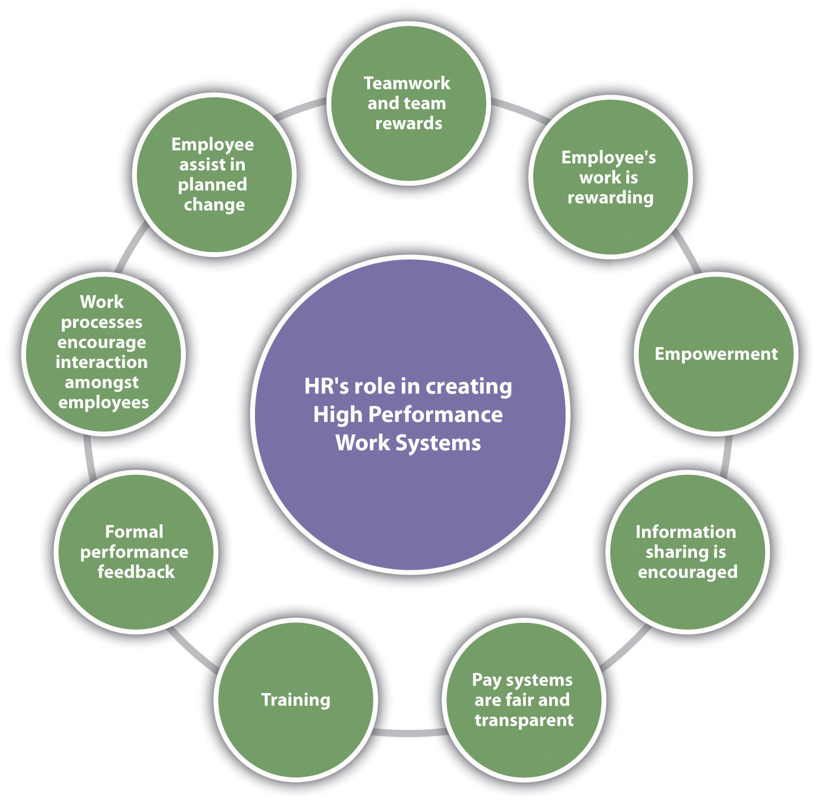

Slide 19
The HR plan contains the following activities:
(i) Recruitment,
(ii) Training and Re-training,
(iii) Productivity,
(iv) Redeployment, and
(v) Retention.

Slide 20
Redeployment takes the form of transfers. In case of estimation of surplus and not deficit for the entire organisation, then trade unions have to be consulted before going for retrenchment and redundancy. Redundancy plan includes provision for compensation, help in getting new jobs, and priority in filling future vacancies for retrenched employees.
Measures for Redeployment, Redundancy / Retrenchment:
(1) Outplacement:
Under this measure career guidance and retraining is provided to the prospective displaced employees so that they can be redeployed elsewhere in the organisation.

Slide 21
(2) Lay Offs:
Layoffs are because of recession in business, power failure, major breakdown etc. of temporary nature. Employees are called back when normal position is restored. Permanent layoff is because of liquidation of the company. The employees can be-absorbed elsewhere in the enterprise where vacancies exist as a result of retirement or death.
(3) leave of Absence without pay:
This is the method employed by the company to reduce the cost of labour and enable employee to pursue his self interest. It also helps the company to eliminate unnecessary jobs. This method helps employees to be aware of future changes.

Slide 22
(4) Work Sharing:
Under this method employees are given the opportunity to share jobs i.e. two employees working half time each. This is a temporary way to solve retrenchment problem.
(5) Reduced work Hours:
Under this method each employee work for less hours, receives less pay.
(6) Voluntary Retirement:
To get rid of overstaffing problems, the government of India has introduced a novel scheme known as Voluntary Retirement Scheme under the caption ‘Golden Handshake’ for its employees.

Slide 23
(7) Attrition:
Under this method the employees who are leaving the jobs at their own create vacancies. The vacancies are not filled, rather freeze and a ban on employment is imposed.
Retention Plan:
When organisations faced the shortage of some categories of employees they adhere to retention of the existing employees.
Retention pain covers the following:
Bringing the salary to the same level as exist in comparable enterprises preventing the employees to quit the organisation for better prospect in other organisations.
(2) Opportunities for career development is provided to the employees through training and development, by giving challenging assignment etc.

Slide 24
(3) More fringe benefits are offered.
(4) Better working conditions are provided.
(5) Extensive participation of employees in decision making is encouraged.
(6) Higher level jobs are offered to the existing employees deserving qualifications, skills and potentialities.
(7) Effective method for grievance redressal and conflict resolution is adopted.
(8) Better facilities for interpersonal relations are created.

Slide 25
Strategic human resource management (SHRM)
is the process involved in aligning human capital with the long-term goals of an organization.
Its main aim is to improve the performance of an organization.
SHRM is involved in processes that are future-oriented in the development and implementation of human resource programs involved in solving problems in business.
SHRM is founded on three major pillars, which include:
Human Capital - SHRM recognizes that human capital is not just a resource but an organization's assets that provide a competitive edge.
Planning - With proper planning, changes are achievable so long as they align with the needs and objectives of the organization
Business competition - The main aim of SHRM is to focus on ways that a firm can take an edge over its business competitors.

Slide 26
SHRM involves organizational goals in alignment with the available human capital. Fostering innovation, improving overall performance, and improving human fulfillment are the main goals of SHRM.
Purposeful hiring and effective communication are examples of SHRM. They both steer the organization towards its long-term goal. Effective communication fosters transparency and creates an open forum discussion where various concerns are addressed.
SHRM is used to create a framework that links the management of people and the development of practices that align with the long-term goals.
SHRM differs from HRM in the sense that it is involved in framing human resource strategies so that they direct the efforts of the employees to align with the organizational goal. SHRM is practiced by HR departments when they work with other departments within an organization to help understand the goals of each department and develop strategies that align with the organizational goals. It takes each department to work together to reach the goals of an organization. In this sense, SHRM is a partner in organizational success.

Slide 27
What is workforce diversity?
Before you can start managing diversity in the workplace, you have to know what it is. And the definition may surprise you.
Diversity is anything that makes people different from one another. I’m sure you know you shouldn’t discriminate based on race, gender, national origin or disability. But there’s more.
Religion, age, sexual orientation, citizenship, political affiliation or opinions, military service, mental and physical conditions, personality, education, favorite sports team – all of these fall under the umbrella of diversity, which, if not managed correctly, can open the door to charges of discrimination or employee relations matters.

Slide 28
What are the benefits of diversity in the workplace for employees?
Conflict reduction
Within a diverse workplace, employees can better understand each other's differences.
This will often help to reduce conflicts between even the most different team members; and will often unite people with a common purpose rather than divide them.
Increased confidence
​When employees' recognise that differences are embraced and celebrated in an organisation, they are likely to also be more confident in their own unique qualities.

Slide 29
Encouraging diversity can help to boost confidence and performance from individual team members, who may be more easily able to express their ideas, become closer to their colleagues and enjoy and take pride in their work.
Boosting employee engagement
​Employees are far more likely to perform well in an environment where diversity and inclusion are top priority.

Slide 30
What are the benefits of diversity in the workplace for employers?
Increased range of ideas.
​One of the key benefits of diversity in society is the vast range of ideas that can be explored.
Diversity in the workplace will often result in a much broader spectrum of creativity, from people with different backgrounds, skills and experiences.
A wider range of different perspectives will be highly beneficial across all teams; from marketing to finance.

Slide 31
Increased employee engagement
​Generally speaking, employees who feel included and wanted will be more engaged and motivated to do well.
In turn, a more engaged team will often yield better team performance; making it a win-win for employers.
Boosts company reputation & simplifies recruitment processes
​Diversity in the workplace will help to build a great reputation for the company; especially important when you are looking to hire and retain talent.

Slide 32
Especially in terms of graduate recruitment, D&I can play a huge role in attracting candidates to your business; if done well, it can also help you stand out from the bigger firms.
Wider talent pool to choose from
​Companies that only hire men, for example, are limiting themselves to the skills of half the population, this is just one of the many benefits of gender diversity in the workplace.
Helps you to understand your customers better
​Having a more diverse team will help your company gain a broader understanding of your customers, what they want and what they look for.

Slide 33
Who knows? Your company could be missing out on a huge group of potential customers that could be explored by hiring more diversely.
Reduce employee turnover
​Companies with a diverse workforce will tend to retain employees for longer, because ultimately employees who feel accepted and valued will be much less likely to leave.
Likewise, companies who clearly value career development, and really care about their employees, will tend to have a much higher retention rate than those who don't.

Slide 34
Marriott International Industry: Hospitality
In a close second place on DiversityInc's Top 50 Companies, Marriott recently launched their Serve 360 plan, whereby they invested $5m in order for women, people with disabilities, veterans, refugees and more to learn hospitality skills.
Not every company will be able to afford $5m; but it does point to the value of investing in professional development.

Slide 35
Accenture PLC Industry: Professional Services
Accenture is often ranked within the top companies for diversity (Thompson Reuters' 2018 Diversity and Inclusion Index ranked Accenture as it's no.1 most diverse company), and though this is largely due to gender representation within their workforce, they have also been applauded for encouraging the inclusion of many different groups.
Diversity training within the company is broken into three different categories; 1) Diversity Awareness, to help people understand the benefits of working with a diverse organisation,
2) Diversity Management, to help team leaders to successful manage diverse teams and
3) Professional Development, to enable minority groups to develop valuable new skills.

Slide 36
Challenges of diversity in the workplace
Communication barriers
Hiring employees from a range of cultures and backgrounds has fantastic benefits for businesses; but can occasionally result in communication or language barriers within a team.
This can sometimes lead to frustration amongst employees and productivity loss. Embracing Business Diversity: Is Technology the Answer?

Slide 37
Employee requirements
Whether it's a VISA or specific cultural requirements, hiring employees from different countries can be tricky; especially if you are a relatively young company.
As well as posing a logistical challenge, it's important to remember that these accommodations can also sometimes be an added business cost to factor into your hiring plans.
Gender equality issues
Salary inequality between men and women has been a huge topic of discussion in recent years. Individuals that are treated unequally can become demotivated and often choose to leave, causing increases in staff turnover.

Slide 38
Generational differences
In teams where there is a wide age range, especially if the company is recruiting graduates, there may be some generational differences or generation gaps.
This could potentially hinder discussions on certain subjects; millennials account for the majority of UK workers, which is evolving today’s corporate culture.
Conflicting beliefs
Conflicts can arise in the workplace due to differences in religious, political or cultural beliefs, and unfortunately discrimination and prejudice still occurs in some corporate environments.

Slide 39
Disability discrimination
The workplace can be tough for employees with a physical or mental disability.
In a recent study on disability and employment 12% of employers are concerned that disabled employees will take more time off work and 19% believe that it is expensive to hire individuals with a disability due to costs involved in adapting the workplace.
Isolated individuals
Sometimes employees can feel left out or isolated when groups of other individuals with similar backgrounds and characteristics, form 'cliques' or social circles.

Slide 40

Competitive Advantage In Human Resource

Slide 41
A traditional source of competitive advantage has been eroded. Now it is believed that productivity is through people.
The human factor is the only organizational resource that can develop a competitive advantage.
Porter argues that people are becoming a significant differentiating factor.
Managers should select those people who are more intelligent, better trained, more motivated, and more committed.

Slide 42
Successful companies in the USA, for their sustained advantage, tend to rely not on technology, patents, or strategic position, but on the way they manage their workforce.
Employment Security
Selective Recruiting
High and Lucrative Wages
Incentive Pay
Employee Ownership
Employee Empowerment and Participation
Information Sharing
Training and Development of Skills
Treat People with Respect and Dignity
Wage Compression
Promotion from Within

Slide 43
Employment Security
Employment security is a critical element of a high-performance work arrangement. The security of employment signals a longstanding commitment to its workforce.
Feeling of stable employment may generate loyalty, commitment, or willingness to expend extra efforts for the organization’s benefits.
The security of employment contributes to training as both employer and employee have more significant incentives to invest in training because there is some assurance that the employment relationship will be of sufficient duration to earn a return on the time and resources expended in skill development.

Slide 44
Selective Recruiting
Organizations serious about making a profit through people will expend the efforts needed to recruit the right people in the first place.
Japanese companies have a reputation for their extensive screening of employees. Organizations need to have a large applicant pool to select the right person.
Firms serious about selection put applicants through several rounds of interviews and a rigorous selection procedure.
Screening is done carefully to find people who could work better in the new work environment, learn and develop quickly, and need less supervision.

Slide 45
High and Lucrative Wages
An organization can attract and retain qualified candidates if it pays a high and lucrative pay package.
Higher wages tend to attract more outstanding applicants, permitting the organization to be more selective in finding people who will be committed to the organization. Higher wages send a message that the organization values its people.
Low labor costs cannot ensure competitive success for a long time.

Slide 46
Incentive Pay
The pay system should be based on the performance or productivity of employees.
Employees will contribute more if they earn more. The contingent incentive can take many forms, such as profit sharing, profit sharing, stock ownership, pay for skills, or various forms of individual or team incentives.
Microsoft, for example, encourages sharing ownership. When employees are owners, they act and think like owners.

Slide 47
Employee Ownership
Organizations should make an employee a mini-employer. A stock ownership plan can do this. This may increase their sense of ownership.
Employee ownership reduces conflict between labor and capital. Employee ownership puts stock in the hands of people.
These employees are more inclined to take a long term view of the organization, its investment policies and strategies, and less likely to support hostile takeovers and acquisitions.
It has a positive effect on the firm’s performance if managed properly.
The stock ownership plan makes the employee a mini-employer. This may increase their sense of belongingness and ownership.

Slide 48
Employee Empowerment and Participation
Empowerment indicates many things to many experts. It refers to mutual influence, creative power distribution, and shared responsibility.
It is a democratic and long-lasting process.
The basic change involves moving from a system of hierarchical control and coordination of activity to one in which lower-level employees are permitted to do things to increase performance.
In Germany, for example, employee empowerment in the board of directors occurs through the system of co-determination. It is also known as industrial democracy.

Slide 49
Information Sharing
Information sharing is an essential element of high-performance work systems.
The sharing of information on issues like budget, strategy, and financial performance conveys the people of an organization that they are trusted.
Use it to teach people how to work together to achieve common goals and thereby gain control over their lives. Provide people with information that allows them to make the right decisions”.

Slide 50
Training and Development of Skills
All of this requires a skilled and motivated workforce that has the knowledge and capability to perform the requisite tasks.
As time goes on, employee skills may become obsolete.
They need to be retrained to upgrade and acquire new skills.
Training also changes and modifies employee attitudes and behaviors. Trained people must be placed in jobs where they can apply their acquired skills.

Slide 51
Treat People with Respect and Dignity
Dignity is a term used in moral, ethical, legal, and political discussions to signify that human being has an innate right to be valued and receive ethical treatment.
At the heart of human rights is the belief that everybody should be treated equally and with dignity – no matter their circumstances. This means that nobody should be tortured or treated as an inhuman or degrading way. It also means that nobody has the right to ‘own’ another person or to force them to work under threat of punishment.
For example, if you are arrested and charged, you should not be treated unfairly, and your trial should be fair. The dignity of labor indicates that all types of jobs are respected equally, and no occupation is considered superior.

Slide 52
Every work has some dignity attached to it. It is improper for anybody to think that a certain kind of work is undignified or below the status. No work is meant high or low.
Wage Compression
Pay differential among the levels of management should be lower. Wage compression between senior managers and employees will reduce status differences and develop a sense of common fate.
A huge pay gap may damage the cooperative spirit between managers and workers. The high pay gap causes employees to feel less valued. The pay gap is the lowest in Japan and the highest in the USA.
Pay inequities exist in all public and private sector organizations and may be caused by overtime, talent acquisition, reorganizations, demotions, reassignments & transfers, demand for technical expertise, and seniority.

Slide 53
Promotion from Within
This practice may boost employee morale.
It encourages training and skill development because of the availability of promotion opportunities within the firm bind workers to employers and vice versa.
Promotion is a reward that is status-based. It provides a sense of fairness and justice in the workplace.
It facilitates decentralization, participation, and delegation because it helps promote trust across hierarchical levels.

Slide 54
Managing the Customer – Employee Interaction
Examples of Customer Interactions
Customer Interactions in Marketing
A customer sees an advertisement for your brand on social media and comments on it.
A customer sees store signage that details features of a specific product or service.
A customer signs up for your email newsletter to receive weekly updates and promotions.
A customer goes to one of your company events.

Slide 55
Customer Interactions in Sales
A customer calls your support line and asks to speak with a sales representative.
A customer is surfing your website and decides to open a live chat conversation with a sales representative.
A customer receives an email from your sales team and schedules a meeting.
A sales representative calls a customer to see how they are liking their new product or service.
A sales representative emails a customer to follow up on a conversation that had earlier.

Slide 56
Customer Interactions in Customer Service
A customer calls a support line to get help with a product or service.
A customer has a question about a product, service, or marketing promotion, and reaches out to your brand on social media.
A customer who's upset with their customer experience writes a negative review of your brand.

Slide 57
Customers interact with your business in many different ways.
Email
Phone
Live Chat
Social Media
Webpage
Live Video
In-Person
Snail Mail
Customer interactions give businesses the data needed to improve customer satisfaction.

Slide 58
Customer Interaction Management
Show empathy and gratitude.
Be conscientious.
Be transparent and communicative.
Ask for and act on customer feedback.
Surprise and delight your customers.
Go where your customers are.
Talk like a human.
Give a gift that gains their loyalty.

Slide 59
Show empathy and gratitude.
Are you familiar with the golden rule? "Treat others as you want to be treated.“
Thank your customers — for everything. Thank them for their patience if your company experiences an outage or disruption in service. Thank them for understanding if you or your company makes an error. Thank them for their loyalty when they renew or buy again. Thank them for taking the time to share their feedback, whether it's good or bad.
Be empathic in your responses to customer complaints and issues. Say "I'm sorry" for whatever the issue is impacting in their day-to-day. The issue could be losing them, time or money, or just causing a tremendous headache. You don't always know what's going on in your customers' daily lives, so err on the side of apologetic if they come to you with an issue — great or small.

Slide 60
2. Be conscientious.
It's of utmost importance to be conscientious and to responsibly follow-up to every customer communication you engage in with a solution, a forum for feedback, or helpful educational resources they can benefit from.
If you can't solve a customer's problem with them in the first interaction, provide them with an exact and reasonable timeframe within which they can expect a resolution. Set a clear time and date, and put the responsibility on your plate to follow up.
If your customer runs into an issue that you resolve, follow up with them a week or two later to make sure they aren't still running into the same issue.
Better yet, do research to investigate when your customers typically encounter issues with your product, and reach out proactively with educational communications to try to prevent that friction in the first place.

Slide 61
3. Be transparent and communicative.
Particularly if your product or service concerns customers' personal data or information, or if your product serves as a system of record for a customer's own business, you need to take your responsibility to your customers seriously.
In today's era of data breaches and credit card hacking, customers want to understand what you're doing to fix problems and prevent them from happening again.
Make sure you're prepared with transparent customer communications during times like these — and if you're not, ask your team manager or director for better guidance.

Slide 62
4. Ask for and act on customer feedback.
Regularly asking customers for feedback via surveys is an effective way to identify potential problems before they cause your customers to churn.
Surveys also provide customers with an avenue to voice their thoughts on your product or your customer service in a way that makes them truly feel valued, and their specific feedback on 1:1 interactions with employees allows you to better hone your processes — or to shout out employees going above and beyond.

Slide 63
5. Delight your customers whenever you can.
You don't necessarily need to surprise them with a gift or a discount (although those can be nice).
Sometimes, something as simple as a thank you letter, company swag, or a shoutout on social media can go a long way towards building goodwill and an emotional connection with your customers.
And an emotional connection can sometimes be a bigger predictor of loyalty than responses to customer satisfaction surveys.

Slide 64
6. Go where your customers are.
As a customer, nothing annoys me more than when I send a Twitter DM to a company to complain about something, and they reply with a number I can call to voice my concerns.
I'm already experiencing friction dealing with an issue with the product — I shouldn't have to wait on hold to hear from a customer support rep, too.
There are always exceptions to this — sometimes, you just have to talk out an issue or hop on a video call — but you should make every effort to keep communications on the same platform where your customer originally asked you for help.
This helps you engage with customers faster to get them the answer they need.

Slide 65
7. Talk like a human.
If you're in the middle of solving a customer issue, feel free to keep language professional.
But once you've solved a customer's problem, or if a customer is reaching out to share positive feedback, feel free to be less scripted, and more yourself.
For example, if customers are reaching out to you on Twitter, don't be shy about responding back to them with a GIF or a hashtag.
If you're leaving them a comment on Instagram, try to work in an emoji.
Little personal touches can endear you to your customers and make them more excited to connect with you.

Slide 66
Give a gift that gains their loyalty.
Thank you cards are great, but customers admire it when brands go the extra mile by sending them nice little gifts.
Not only do gifts instill memories in customers, but they also add a special layer of happiness.
So the next time you want to thank your customers, consider emailing them a gift card, grocery coupon, or a discount on your service/products.
We are living in a world that's highly competitive, and the way you deal with a customer leaves a big impact on your brand name.

Slide 67
That's why customer interaction must be done with extra care, as it serves as an incredible opportunity to grow your business.
The journey from customer interaction to customer loyalty isn't overnight, but it isn't complicated either.
All it takes is the right loyalty rewards to appreciate them. Happy customers = Loyal customers! Let's not forget that.

Slide 68

Employee Empowerment

Slide 69
When someone is empowered, they have the ability to accomplish something ー and they know it, giving them the confidence needed to succeed.
Employee empowerment refers to the manner in which companies provide their employees with anything and everything they need to succeed.
Companies that are interested in empowering employees should act on the following:
Give employees a voice by regularly soliciting and acting on their feedback.
Provide opportunities for employees to grow through more autonomy, additional responsibilities, or even an entirely new role.

Slide 70
Recognize employees frequently to increase their engagement and confidence in their own abilities.
And, of course, provide employees with the tools, training, and authority they need to excel.
Empowerment is defined as “the giving or delegation of power or authority; authorization; the giving of an ability; enablement or permission.”

Slide 71
Service Failures:
Failures in customer service are inevitable.
Whether you're just starting out as a business or a well-oiled machine, you're bound to slip up and disappoint a customer at some point; your reservations desk forgets to accommodate a special request, your airline has to cancel a flight to a popular holiday destination, or a waiter in your restaurant is having a bad day and is impatient with an elderly couple.
The key lies in mastering service recovery. With the right skills, and a little training, companies can not only recover from their service failures and win back customers - but learn from their mistakes and come out stronger on the other end.

Slide 72
5 Basic Steps To Customer Service Recovery
Offer a sincere apology Customers want to be heard, respected and understood. Make sure that you stay calm, listen, show empathy and are respectful towards their feelings and frustrations.
Don't offer them a scripted apology or try to sweep the mistake under the rug.
Simply acknowledging their frustration and apologizing will already go a long way in diffusing the situation, so that you can work together to settle on an acceptable solution.

Slide 73
Analyze the situation
Ask the customer to describe the problem in detail and take time to review and analyze how the issue came about.
Keep a detailed log of the complaint, including the time, date and nature of the problem, and whether it's a standalone or recurring issue.
And make sure to record the customer's contact details, so that you can follow-up with them after-the-fact.

Slide 74
Offer a solution
For example, if your customer had a bad experience in one of your restaurants, offer them a discount on their meal, or a voucher for free drinks for their next visit.
Or if a customer's requests for a specific room were not accommodated, see if you can still find a way to cater to their wishes, and if not, offer them a bottle of wine or a box of chocolates as an apologetic gesture.
Follow-up
Every complaint, big or small, calls for a follow-up to check if the customer's issue was resolved and if they're happy with how it was handled.
Give them a call, or send a card or email to let them know you're still concerned about their satisfaction.

Slide 75
Document Carefully document every complaint - including the dates, causes, the concerned staff members or departments and when and how it was resolved.
This will help you keep track of your progress and help you determine if there are any recurring themes or underlying causes that need to be addressed.

Slide 76
What Is a Frontline Worker?
Frontline workers are employees in an organization that provide some essential service to the general public.
Not all essential workers are considered frontline workers.
The distinction is based on how much interaction they have with people, and whether they’re customers or recipients of the service provided.
For example, frontline workers have a higher rate of face-to-face interactions than essential workers, who aren’t necessarily required to work in public-facing roles.

Slide 77
However, it’s crucial to identify all types of frontline jobs, so people know who makes up most of the country’s workforce. Here is a list of some common occupations where frontline workers work:
Health care: Nurses, doctors, and other medical professionals that see patients and provide treatment services
Education and child care: Teachers, special education professionals, and day care specialists
Local and national government: Politicians, elected officials, and federal government workers
Food and goods: Food supply chain workers, those in food sales and distribution
Public safety: Law enforcement, armed forces, firefighters, and other security workers
Transport: Public transportation workers in air, rail, road, and water

Slide 78
Utilities, communications, and financial services: Oil, gas, and electrical industries, as well as postal service workers and waste disposal employees
Frontline employees can work in various environments, ranging from grocery stores to out and about in local neighborhoods.
Where Frontline Employees Work
Stores
Restaurants
Beauty salons
Driving trucks
Hospitals
Construction sites
Factories
Educational institutions
Pharmacies
Warehouse

Slide 79
Here are some of those facts that can help people understand how crucial they are to a functioning society. In addition, it’s the responsibility of industry leaders to be aware of these facts to improve their frontline workforce:
Members of the health care industry represent 20% of all frontline workers in the United States.
Frontline workers tend to receive lower-than-average wages compared to the overall group of essential workers.
42% of all workers are frontline workers.
Frontline workers are typically less educated, with a higher share of high school dropouts.
Frontline workers tend to make more through unemployment benefits than working their actual job, meaning wages are generally too low for these workers.
Frontline workers sometimes lack insurance benefits and paid sick leave.

Slide 80
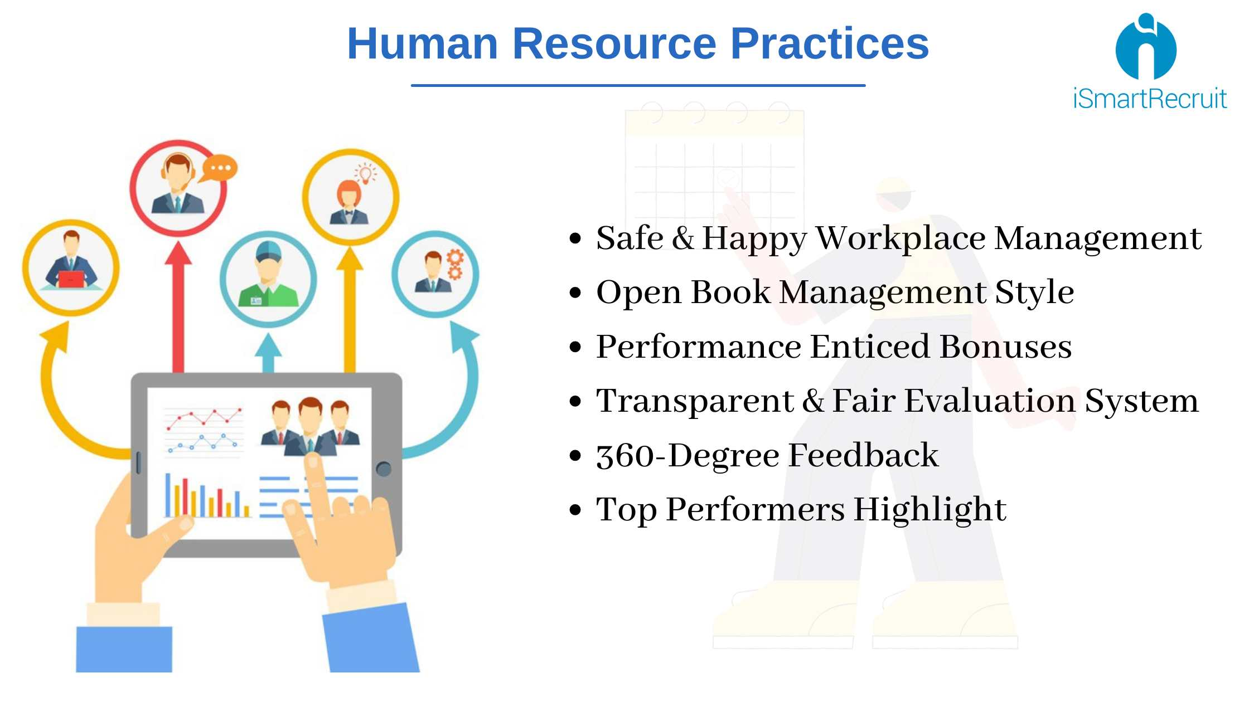
HR Best Practices

Slide 81
HR Best Practice #1: Safe and happy workplace management
COVID-19 is highlighting the need to keep employees healthy and take care of their well-being.
Therefore, HR should develop and maintain standards that ensure a safe workplace where hires love to be and can perform well.

Slide 82
HR Best Practice #2: Open book management style
Just like everyone else, employees hate uncertainties and doubts, which is why you should have an open-management and a lead transparent business.
Keep your employees updated and in the loop with the company's on-going as that will increase their loyalty and productivity.

Slide 83
HR Best Practice #3: Performance enticed bonuses
One of the best ways to ensure a company will reach the desired levels of profitability while also keeping employees efficient is to create bonuses according to the teams and individual performance and success.

Slide 84
HR Best Practice #4: Transparent and fair evaluation system
A company should ensure that their evaluation system is tailored to its corporate goals and that all performance reports are transparent and available to employees.
It's recommendable to track their work throughout the year and base evaluation on achievements.

Slide 85
HR Best Practice #5: 360-Degree feedback
All organization's personnel should receive genuine insights into their performance and what they can do better. A system that allows all-encompassing feedback from all team members, including seniors.
Ensure that everyone receives constructive criticism and advice.

Slide 86
HR Best Practice #6: Top performers highlight
If you want to motivate your staff and reward them for their accomplishments.
Ensure recognition of the best performers and make them visible across all departments.

Slide 87
What Is Workplace Flexibility?
The easiest way to define workplace flexibility is to think of it as an agreement between employer and employee. The agreement usually consists of three components. Employees can:
Choose where they work from
Create a work schedule that works best for them
Schedule their work day however they want
As an employer, you may think that this sounds like a freelancer schedule. And, freelancing is, indeed, one category of flexible work. However, flexible work can also include:
Part-time work
Fully remote teams
Work-from-anywhere arrangements
Compressed work weeks (working 40 hours over four days instead of five)

Slide 88
What Are the Benefits of Flexible Work for Companies?
To be clear, the above components of workplace flexibility aren’t as straightforward as they might seem. The reality is that even in the most flexible workplace, employers may still have to impose some restrictions on flexible work.
For example, while flexible workers may be able to work whatever hours suit their work style and let them get their work done, you may require that employees work certain “core hours” that overlap with other team members to ensure everyone can make the weekly team meeting or be available for clients in a certain time zone.

Slide 89
1. Improves Retention
Allowing your existing employees to work flexible schedules can help you retain valuable staff. Without a doubt, flexible schedules are one of the most important perks employees want from their employers.
A 2018 survey found that 80% of workers would choose a job that offers a flexible schedule over those that did not. In fact, 30% said that they value flexible work over additional vacation time. And 35% said flexible work is so important to them that they prioritize that over having a more prestigious title or position.
Even more telling, 80% of respondents said they’d be more loyal to their employer if they offered flexible work, and 52% said they’d already tried to negotiate flexible work arrangements with their current employer.
Think of it in terms of dollars and cents. The average company’s cost per hire is around $4,000 to recruit, hire, and train one new staff member. Preventing your workforce from leaving because you offer flexible scheduling could reap you significant cost savings in the long run.

Slide 90
2. Attracts Top Talent
Given that many job seekers are more interested in a flexible schedule than other perks, and that flexible work benefits companies as much as it does employees, it stands to reason that offering flexible schedules can help you recruit more top tier talent.
If none of the above convinces you that offering flexible schedules to staff will benefit your company, consider that over the last 10 years, 83% of businesses have already or are planning to offer flexible schedules to their employees.

Slide 91
3. Improves Diversity
If you’re limiting your candidate pool to a single location (or even a few locations), you’ll have a narrower group of candidates. And if you’re in a homogenous locale, your workforce is likely to become less diverse.
Even if you pay for relocation, you’re asking candidates to be part of a less diverse community, which could be a turn off and cause you to miss out.
A 2019 study found that companies with diverse employees have better performing teams than less diverse organizations. By casting a wide and diverse net, you’re likely to end up with the best candidates possible.
Not only will remote work help your company’s diversity, but it will help your bottom line.

Slide 92
4. Increases Productivity
One of the reasons employers often won’t allow staff to work flexibly is that they think if they can’t keep a watchful eye on their employees, they won’t work. However, working flexibly can actually increase employee productivity.
A 2019 survey of remote workers found that, on average, they work 1.4 more days per month than in-office employees. That translates into 16.8 more work days every year. In addition, in-office workers deal with workplace distractions an average of 37 minutes per day, versus the 27 daily minutes a remote employee experiences.
Furthermore, when you’re in a flexible environment, it forces managers and leadership to evaluate their employees on what actually matters versus their presence in a physical location.
This facilitates a results-oriented culture that emphasizes strong impact and thus, helps the business thrive.

Slide 93
5. Improves Employee Engagement
Engaged employees are those who understand what their role is and how what they do contributes to the company’s success. One of the ways companies create a culture of engagement is by creating a workplace that empowers and respects employees.
When you let people work flexibly, you say that you trust them to get their work done no matter how, when, or where that happens.

Slide 94
6. Provides a Cost-Efficient and Eco-Friendly Choice
Flexible schedules not only save both employee and employer money, they have a positive impact on the environment, too, and help support the UN’s sustainable development goals.
Employees with flexible schedules may not have to commute to the office every day. This saves them money on commuting expenses, work clothing, and eating lunch out every day. Employers save money on their overhead costs. They can rent a smaller office and use less electricity and water.
These changes also result in a lower carbon footprint for both staff and employer. Because staff aren’t commuting as often (if at all), no matter how they get to the office, they aren’t releasing as many harmful emissions into the atmosphere.
And, when employers rent a smaller office and use less water and electricity, they also help reduce their negative impact on the environment.

Slide 95
Talk to a flexible work expert today and discover a better way to recruit remote talent!

